Slide 1

"Newer treatments in diabetes and the role of the diabetes specialist pharmacist"
Samina Ali

Slide 2

A bit about myself…..
Started working in primary care in 2009
Interest in diabetes grew….but luck played a part
Regular clinic in NHS Greater Glasgow and Clyde from 2014
Started joint clinics with diabetes specialist nurses (DSNs)
Completed independent prescribing specialising in diabetes and MSc in 2014
Self employed by a practice to run diabetes clinics from 2016
Diabetes diploma completed in 2018
Diabetes UK pharmacist leadership course in 2019
Started Royal Pharmaceutical Society (RPS) framework for accreditation for consultant pharmacist in diabetes in 2021

Slide 3

objectives
- updates in type 2 diabetes
- updates in type 1 diabetes
- The role of the diabetes specialist pharmacist

Slide 4
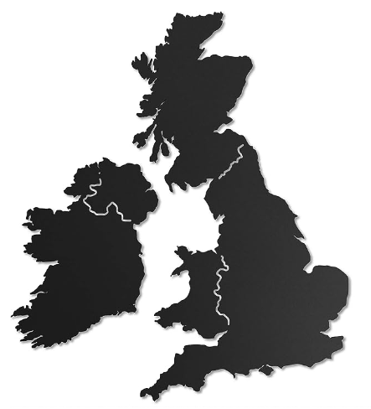
Number of people living with diabetes in the UK tops 5 million for the first time- Diabetes UK
More 4.3 million people in the UK live with diabetes.
850,000 people could be living with diabetes who are yet to be diagnosed

Slide 5
Updates in the management of type 2 diabetes

Slide 6
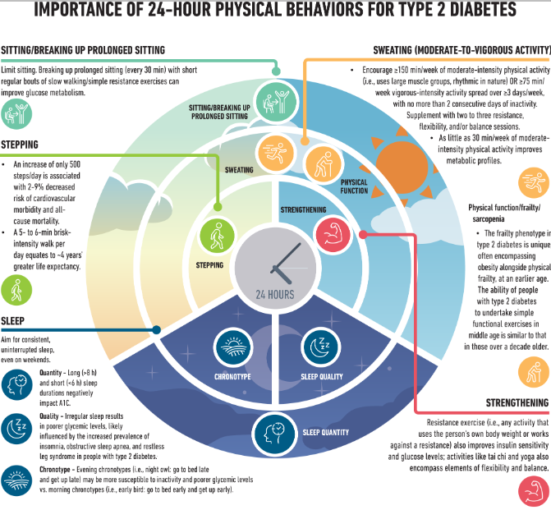

Slide 7



Heart, kidney and diabetes
Diabetes
Heart
Kidney

Slide 8
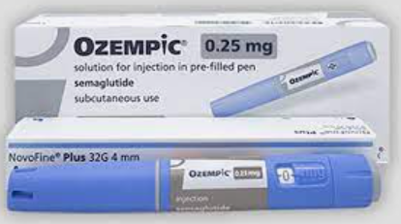
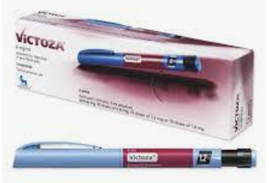

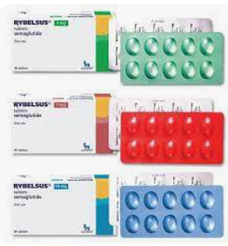
GLP-1RA shortage

Slide 9
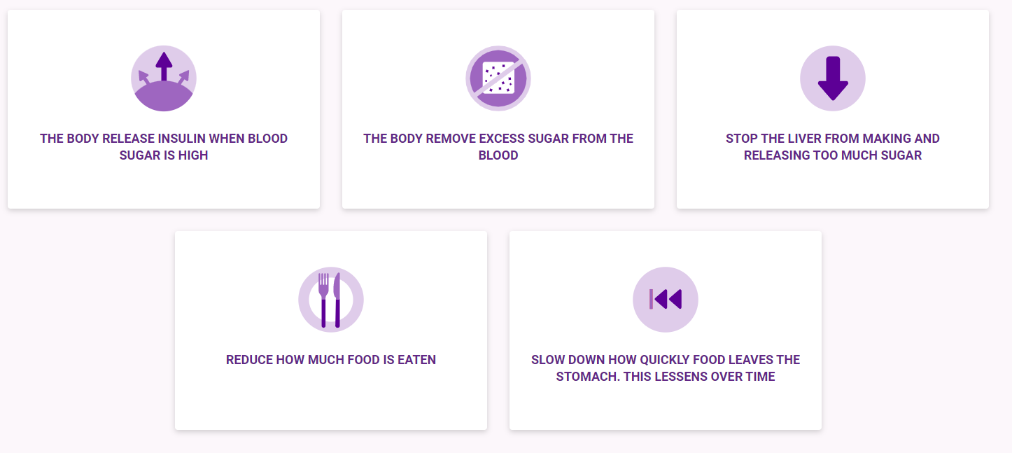
Mounjaro (Tirzepatide)

Slide 10
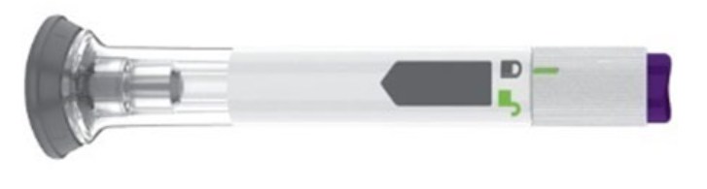
Mounjaro (Tirzepatide)
Once weekly dosing
Available in three doses (5 mg, 10 mg and 15 mg)
BMI>35
Cost?
Available in vial and syringe
Awaiting SMC approval
Approval by NICE in September 2023
Notes:
The normal incretin effect—an enhanced prandial insulin response—is mediated mostly by meal-stimulated release of the intestinal hormones GLP-1 and glucose-dependent insulinotropic peptide (GIP). ¹
Analogues of GLP-1 that act as GLP-1 receptor agonists are established glucose-lowering agents that potentiate insulin release and suppress glucagon in a glucose-dependent manner. GLP-1 receptor agonists also facilitate weight loss via reduced food intake, by creating a feeling of fullness through delayed gastric emptying and by modulating central hunger-satiety controls. GIP probably makes a greater contribution to the normal prandial insulin response than does GLP-1, but GIP was disregarded for therapeutic purposes because its insulinotropic activity is greatly reduced in type 2 diabetes. ²
However, subsequent studies noted that the insulinotropic potency of GIP is restored in individuals with type 2 diabetes if the hyperglycaemia is first reduced by another agent such as insulin. This discovery has brought GIP back into therapeutic consideration, and a new incretin mimetic, tirzepatide, combines GIP receptor agonism with GLP-1 receptor agonism in a single chimeric peptide. ³

Slide 11
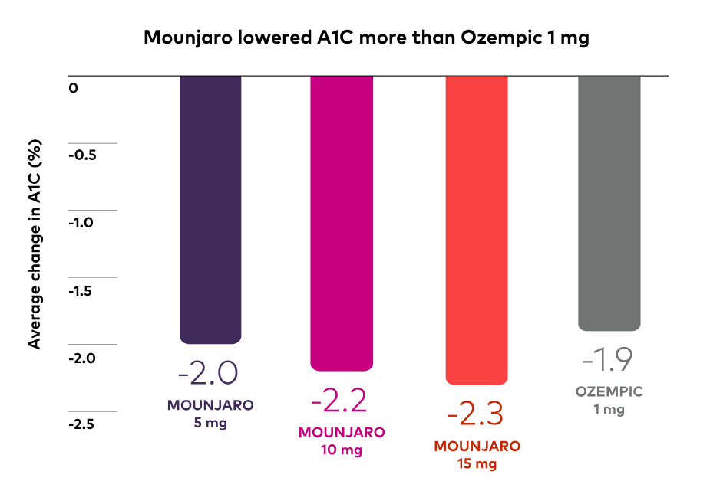
Mounjaro (Tirzepatide)
SURPASS 2 trial- at 40 weeks

Slide 12
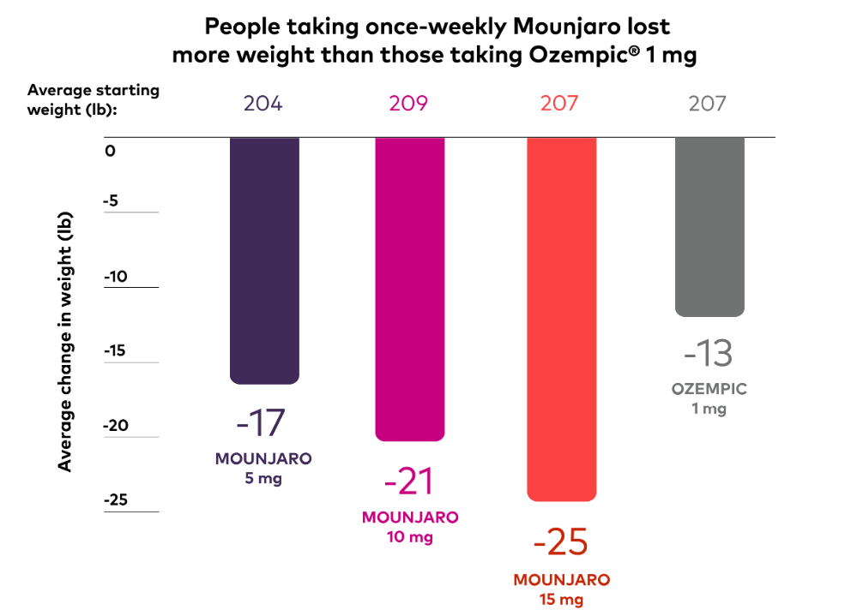
Mounjaro (Tirzepatide)
SURPASS 2 trial- at 40 weeks

Slide 13
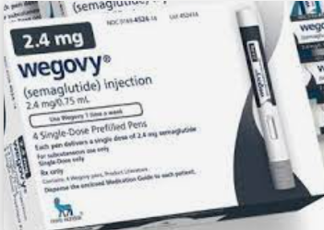
Wegovy (Semaglutide)
BMI (usually 30 and over) and at least one weight-related health condition.
Used in pre-diabetes and type 2 diabetes
Available on NHS and privately

Slide 14
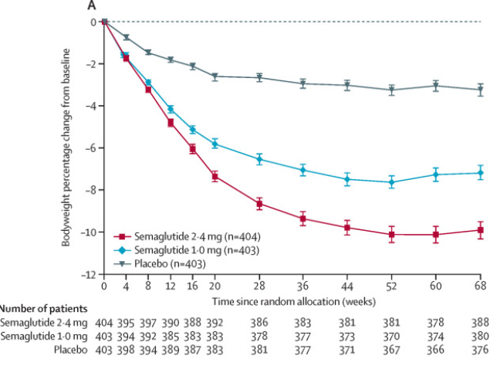
Wegovy (Semaglutide)

Slide 15


Once weekly basal insulin

Slide 16
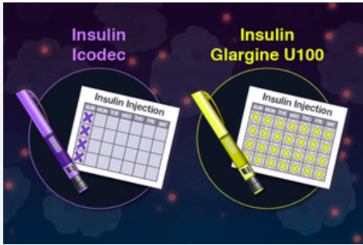
Benefits of once weekly insulin
313 fewer injections per year
Simple fixed dose
Minimal lifestyle disruption
Third party administration time reduced
Pen delivery
When compared with once daily insulin:
Comparable glycaemic control
No significant difference in number of hypos

Slide 17
New(ish) therapies: SGLT2 inhibitor
SGLT2 inhibitor | Therapeutic indication | Extra benefit
Invokana (Canagliflozin) | Type 2 diabetes Diabetes kidney disease | Reduction in cardiovascular death and all cause death
Forxiga (Dapagliflozin) | Type 2 diabetes Heart failure Diabetes kidney disease
Jardiance (Empagliflozin) | Type 2 diabetes Heart failure Diabetes kidney disease | Reduction in cardiovascular death and all cause death
Steglatro (Ertugliflozin) | Type 2 diabetes

Slide 18
Direct study
Overweight (BMI>27) people with type 2 diabetes
800 calorie diet for 3-5 months
Food slowly reintroduced over 2-8 weeks
46% achieved remission
36% were still in remission after 2 years
At year 5, 23% are still in remission

Slide 19
RETUNE study
Slightly overweight (BMI<27) people with type 2 diabetes
800 calories for 2-4 weeks and then 4-6 weeks of eating normally
Cycle repeated until participants lost 10-15% of their body weight
70% of participants went into remission from type 2 diabetes
People needed to lose on average 8% of their body weight to go into remission.

Slide 20
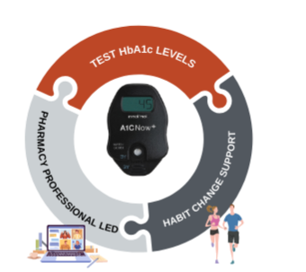
Motivate remission (MoRem)
First device licensed in UK for HbA1c testing at healthcare setting
Can also be used for home monitoring
HbA1c results in less than 5 minutes

Slide 21
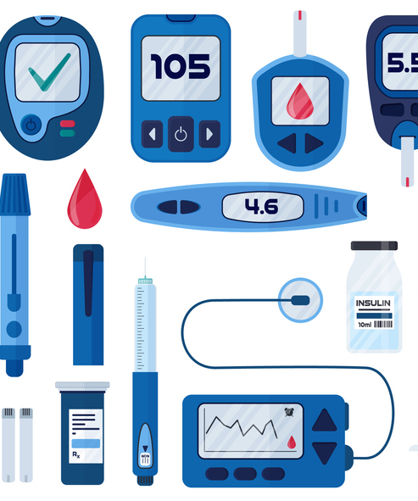
Diabetes and technology

Slide 22
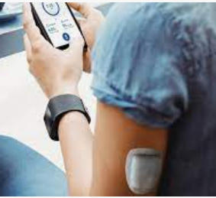
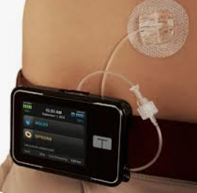
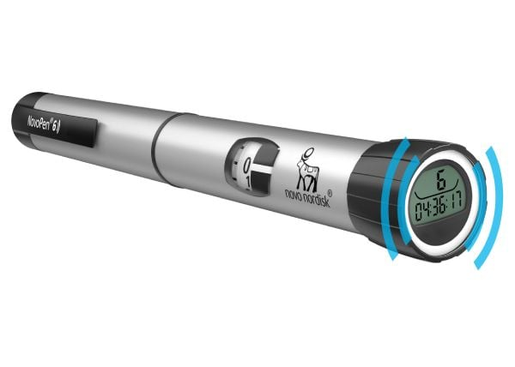
Tech to deliver insulin
Tethered insulin pumps
Tandem T-slim, Medtronic Minimed 780G, Dana, Ypsomed mylife, Ypsopump
2. Patch insulin pump
Omnipod DASH, Omnipod 5, Medtrum Nano
3. Smart insulin pens
Novo Nordisk Novopen 6 and Echo Plus

Slide 23
Tech to measure blood sugars
Flash glucose monitor (FGM)
Freestyle Libre 2 (now a CGM)
2. Continous Glucose Monitor (CGM)
Freestyle Libre 2, 3
Dexcom One, G6, G7
Medtronic G4
GlucoRx Aidec
Medtrum Nano

Slide 24
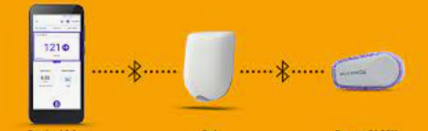
Hybrid Closed-loop
Insulin pump + CGM + algorithm
The technology talks to each other
Also called an “artificial pancreas”
Different pumps and CGMs work together depending on what companies in the industry have teamed up

Slide 25
Role of the diabetes specialist pharmacist

Slide 26
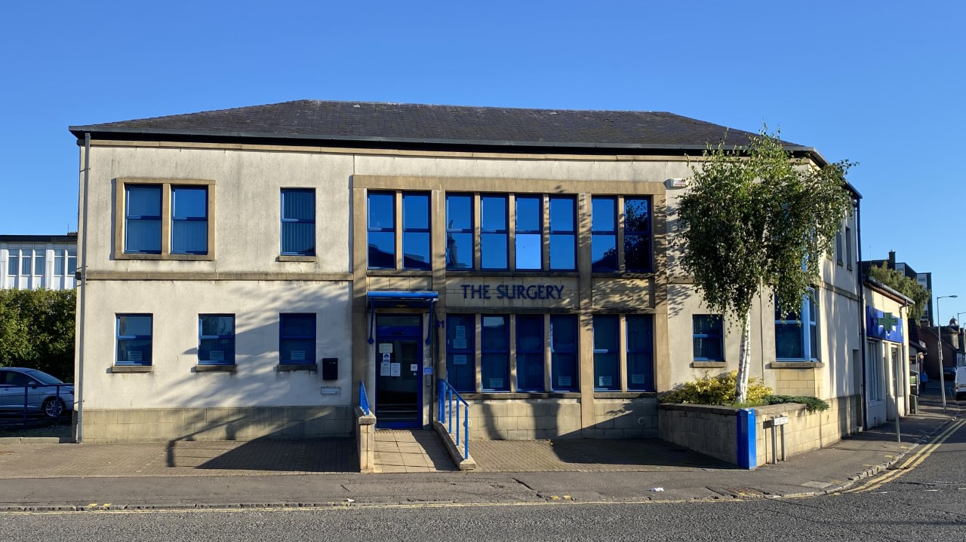

Slide 27

Medication
Initiate/reduce/increase | Oral diabetes drugs Insulin GLP-1RA Statins Blood pressure
Start Freestyle Libre
Speak to diabetes consultant
Polypharmacy review

Slide 28

Checks done during review
Feet check
Blood pressure check
Urine check
Injection site check

Slide 29

Referral/signposting
Vaccine service
GP
Podiatrist
Signposting to retinal screening
Dietician
Pharmacy NRT service
Physio

Slide 30
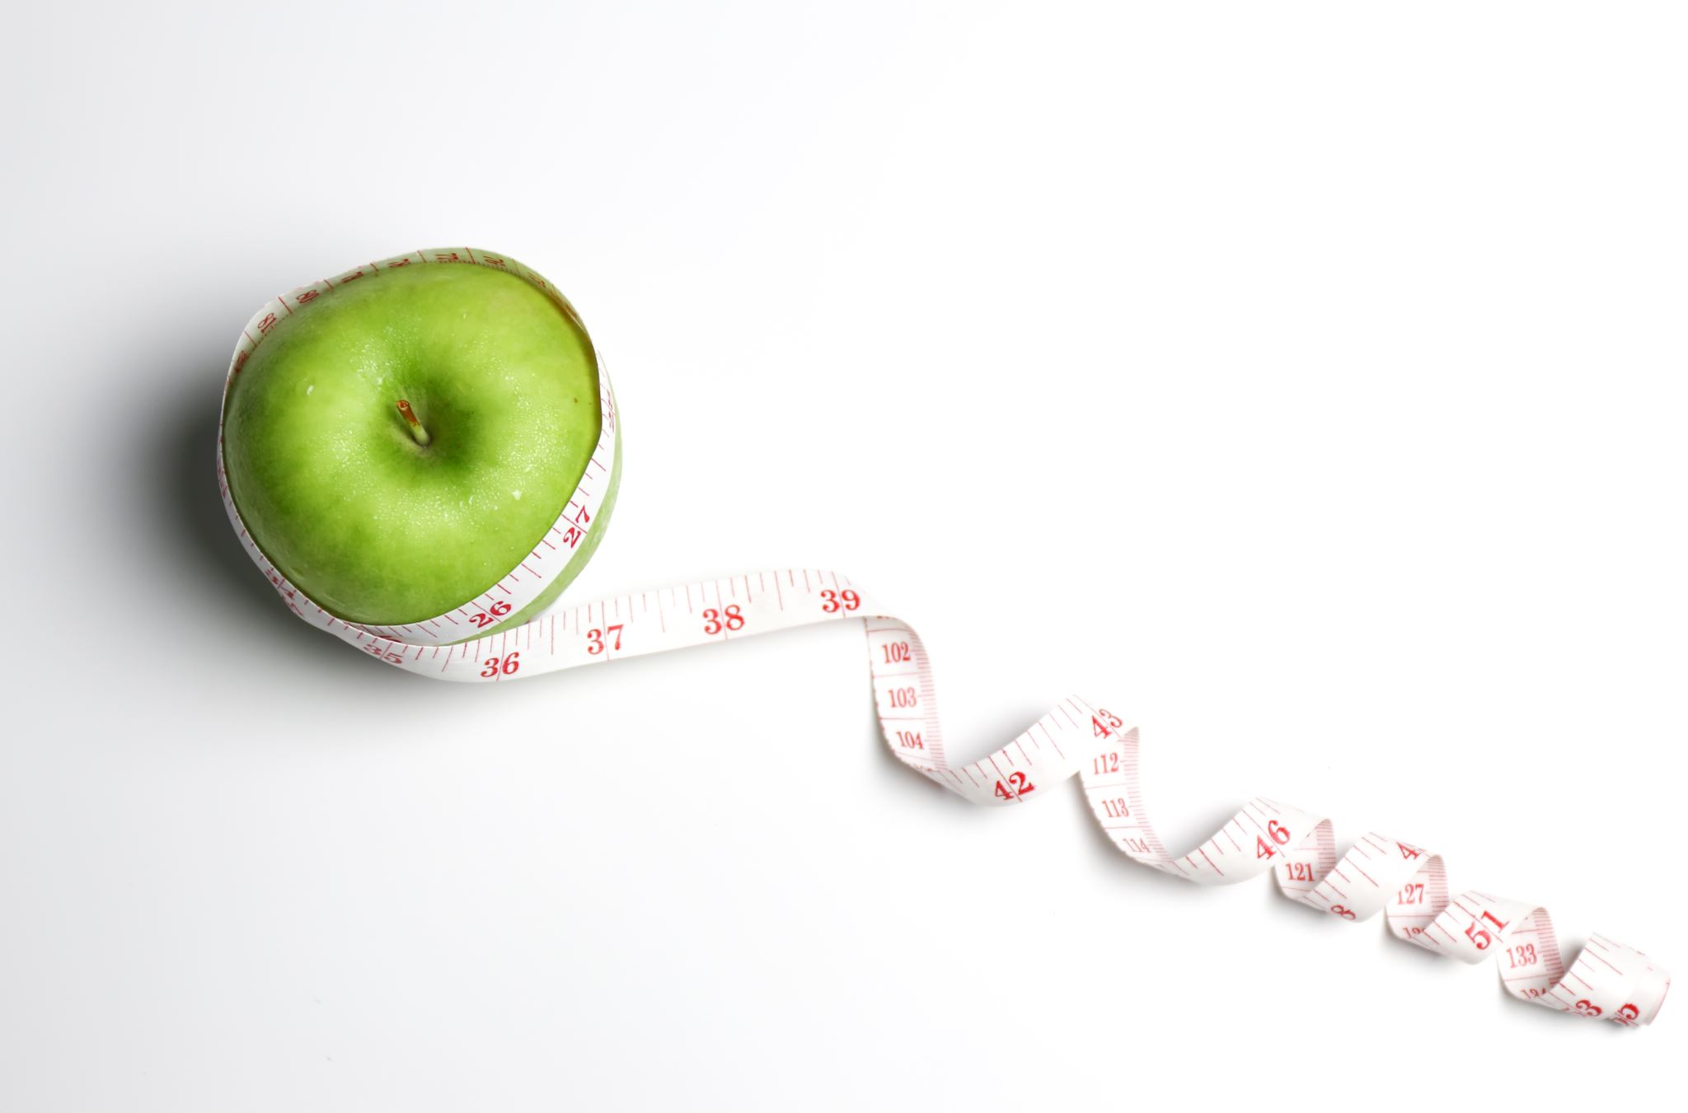
Advice given
Diet
Exercise

Slide 31

Other responsibilities
- Coach pharmacists, practice nurses and GPs
Help colleagues with diabetes queries
Discuss cases to help colleagues manage people with diabetes better

Slide 32
Summary
Newer therapies are on their way!
World of diabetes is constantly evolving
Pharmacists are an integral members of the healthcare team

Slide 33
Thank you for listening!
Any questions??

