Slide 1


Managing Diabetes in Older People in Primary Care – setting the scene for the EuGMS-EDWPOP Guidelines 2023
Professor Alan Sinclair MSc MD FRCP
Foundation for Diabetes Research in Older People (fDROP)
and King’s College, London

Slide 2
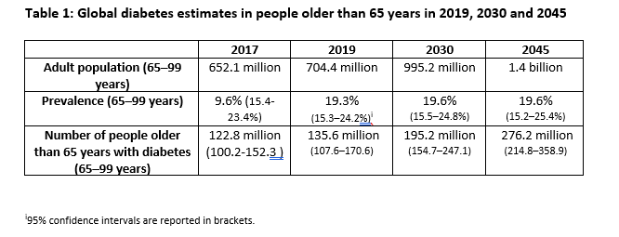
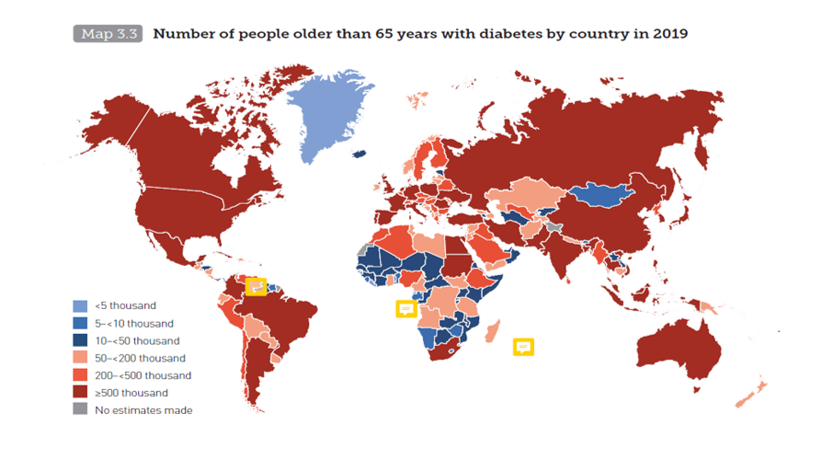
Global diabetes rates in older people – findings from the IDF Atlas 9th edition. Sinclair AJ et al. Diab Res Clin Pract 2020.
Notes:
Work that I undertook for the International Diabetes Federation recently is presented in this slide. In the table on the left shows predicted data on the dramatic rises in diabetes in ageing populations globally over the next 20 years and an increase in overall prevalence to about 20%.
On the right, and looking at the colour coded descriptions of numbers of older people with diabetes per region/country, it shows essentially a global pandemic of this highly prevalent and often ubiquitous disease. What this figure does not show is the tremendous burden of the personal and socio-economic impact that accompanies this disease.

Slide 3
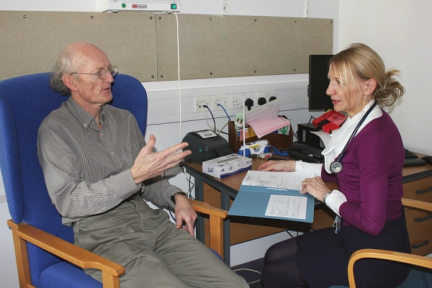
Myth – older people with diabetes are not a special group and can be managed in a simple approach!
What makes them different?
Commonest metabolic disorder in ageing societies
Clinical manifestations at diagnosis are often vague and non-descriptive
Highest rates of comorbidities, lower limb amputations, visual disorders, end-stage renal disease, and is a cause of premature death
High sensitivity to adverse drug reactions and hypoglycaemia
Polypharmacy and Overtreatment common!
Importance of small gains or deficits
- 1-2 points on Barthel (ADL) – bathe or dress
- 1-2 points on IADL – independent mobility
- 2-3 points on MMSE (cognitive screen) – ability to self-care
Risk factor for mobility disturbance and frailty
Increased risk of cognitive impairment and dementia
Extreme importance of preventative actions: to prevent hypoglycaemia, frailty, disability, institutionalisation
Sinclair AJ et al, Diabetic Medicine 2018

Slide 4
Myth – above the age of 65y, there is no excess mortality from diabetes!
Mortality (hazard ratio-adjusted) in Older People with Diabetes (DM) with non-DM as reference
Forbes A, Murrells T, Sinclair AJ, 2016
Overall excess mortality risk:
All = 29%
Males = 21%
Females = 36%36%
The Health Improvement Network (THIN) database: 464 UK general practices: electronic medical records: > 3 million records
Age groups (YRs)
Notes:
What are absolute and relative risks?
Absolute risk of a disease is your risk of developing the disease over a time period. We all have absolute risks of developing various diseases such as heart disease, cancer, stroke, etc. The same absolute risk can be expressed in different ways. For example, say you have a 1 in 10 risk of developing a certain disease in your life. This can also be said to be a 10% risk, or a 0.1 risk - depending on whether you use percentages or decimals.
Relative risk is used to compare the risk in two different groups of people. For example, the groups could be smokers and non-smokers. All sorts of groups are compared to others in medical research to see if belonging to a group increases or decreases your risk of developing certain diseases. For example, research has shown that smokers have a higher risk of developing heart disease compared to (relative to) non-smokers.

Slide 5
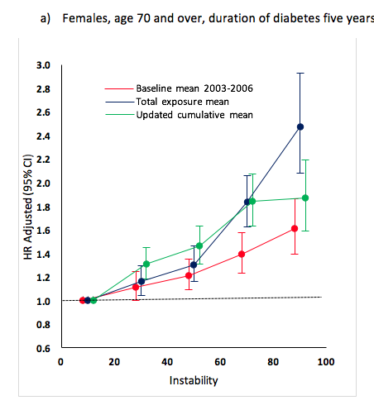
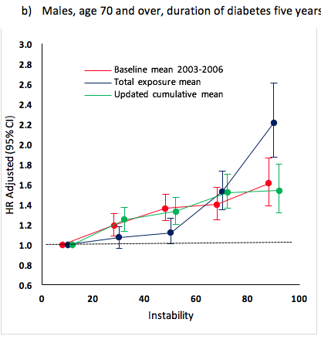
Myth – only absolute levels of HbA1c matter - Adjusted HRs by HbA1c level for all-cause mortality in women (a) and men (b) – importance of a stable level of glycaemia. Lancet D&E, 2018
Error bars are 95% CIs. HR=hazard
Forbes A, Murrels T, Sinclair AJ, Lancet D&E 2018

Slide 6
Inherent Difficulties in Managing Older People with Diabetes
The need to consider the significant heterogeneity of an older population of people with diabetes – effects of ageing, changes in renal function, varied susceptibilities to hypoglycaemia, socioeconomic status
The need to consider varying clinical trajectories
The need to consider the multimorbidity profile and its impact on management
The need to assess the importance and impact of functional loss including frailty, disability and cognitive impairment in setting targets
The need to extrapolate clinical trial evidence from younger populations in the absence of data in older people
The lack of evaluation in clinical guidelines that target older people with diabetes
Sinclair AJ, Abdelhafiz AH, 2022
Notes:
I have presented here more evidence of the inherent difficulties of managing older people with diabetes.
On the left, I have already mentioned the impact of comorbid illness on creating difficulties in management, but here I stress that the heterogeneity of older populations and the likely varying clinical trajectories make treatment difficult. This is compounded by factors shown on the right such as the influence of functional loss and frailty. Thus, it is not surprising that modern clinical guidelines for treating diabetes in older people have many shortfalls which limit their effectiveness. I have had the honour to lead or be part of the writing group of these guidelines and I recognise my own failing in not taking into account these factors.

Slide 7
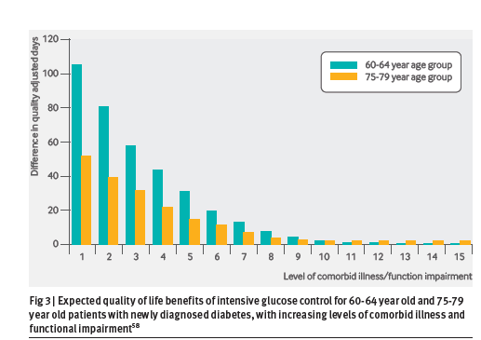
Co-morbid illness and functional loss attenuate the expected benefits of intensive glucose control in older patients with type 2 diabetes Huang ES 2008
Use of decision analysis (multiple prediction models)
Based on UKPDS, NIH model, and Health and Retirement Study data
Simulation for patients aged 40-80y with type 2 diabetes, using 5y age cohort data sets
Compared the projected health benefits of having moderate control (HbA1c 7.9%) with intensive control (HbA1c 7%)
Notes:
We must also remember that the strive for intensive glucose control can be potentially harmful in older people with diabetes and actually may not accrue benefits.
Elbert Huang from Chicago in a simulation model based on UKPDS and US-study data showed that the expected benefits (in terms of quality adjusted days in two older age groups) of lowering HbA1c from 7.9 to 7.0 % progressively declined with the degree of functional loss and comorbidity burden. This appeared so for those at diagnosis of diabetes and for 5 and 10 years after diagnosis.

Slide 8
Results of Subgroup Analyses in Established CVD–Recent Cardiovascular Outcome Trials – but what do they tell us about older people?
Trial | Agent | Outcome | HR, 95% confidence interval
 |  |  | Age <65Y | Age ≥65-75Y | Age ≥75Y
EMPA-REG | Empagliflozin | 3P-MACE | 1.04, 0.84 to 1.29. | 0.74, 0.58 to 0.93. | 0.68, 0.46 to 1.00.
DECLARE-TIMI | Dapagliflozin | Composite CV death or HF hospitalisation | 0.88, 0.72 to 1.07. | 0.77, 0.63, 0.94. | 0.94, 0.65 to 1.36.
CANVAS | Canagliflozin | 3P-MACE | 0.91, 0.76 to 1.10. | 0.80, 0.62 to 0.97. | NR
SGLT-2i meta-analysis | SGLT-2i CV outcome trials | 3P-MACE | 0.95, 0.86 to 1.05. | 0.83, 0.71 to 0.96. | NR
LEADER | Liraglutide | 3P-MACE | 0.78, 0.62 to 0.97. | 0.90, 0.79 to 1.02. | 0.66, 0.49 to 0.89
SUSTAIN-6 | Semaglutide | 3P-MACE | 0.74, 0.52 to 1.05. | 0.72, 0.51 to 1.02 | NR
EXSCEL | Exenatide | 3P-MACE | 1.05, 0.92 to 1.21. | 0.80, 0.71 to 0.91. | NR
GLP-1RA meta-analysis | GLP-1RA CV outcome trials | 3P-MACE | 0.89, 0.76 to 1.03. | 0.86, 0.80 to 0.92. | NR
Older (>75Y) people are less represented in these trials, therefore generalisation of findings is limited by under reporting in this age group.
Notes:
The major cardiovascular outcome trials (CVOTs) of both SGLT2 inhibitors and GLP-1 receptor antagonists shown in this slide demonstrate benefits in key outcomes such as MACE, hospitalization for heart failure, and renal endpoints in both younger and older adult patients. These have been confirmed by meta-analyses of the newer therapies.
However, these are subgroup analyses only and we must take caution - ANIMATE SLIDE
Under-representation of over 75-year olds can limit the interpretation of findings and more specific studies in older patients with type 2 diabetes are needed

Slide 9


Diabetes as a major cause of Mobility Limitation: use of risk scores in the All Wales Research in the Elderly Study (AWARE) 2008
Older diabetics at risk of physical disabilities
Fri Feb 22, 2008 11:38pm GMT
NEW YORK (Reuters Health) - Elderly people with diabetes may be at heightened risk of physical limitations that could hinder their independence, a new study suggests.
British researchers found that among more than 800 adults age 65 or older, those with diabetes were more likely to have problems with walking and performing daily tasks like bathing, climbing stairs and dressing.
Results
Use of a mobility aid as marker of perceived mobility limitation
Controlling for age, hypertension, CVA, COPD, cancer, OA and dementia, diabetes remains significantly associated with mobility limitation: OR 2.1 (1.5-2.83), P<0.001
A predictive model for mobility limitation was used to interpret risk scores for each patient, based on assigning 1 point each for the above controlling factors (with weighting for age)
A cut-off score ≥ 3 correctly identified 65% of those with mobility limitation (sensitivity,53.3%; specificity, 75.4%)
Sinclair AJ, Conroy SP, Bayer AJ: Impact of diabetes on physical function in older people. Diabetes Care. 2008 Feb;31(2):233-5

Slide 10
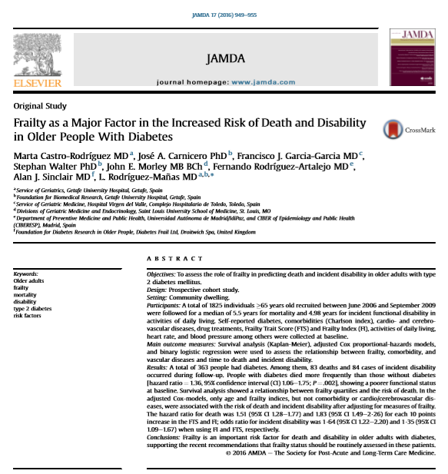
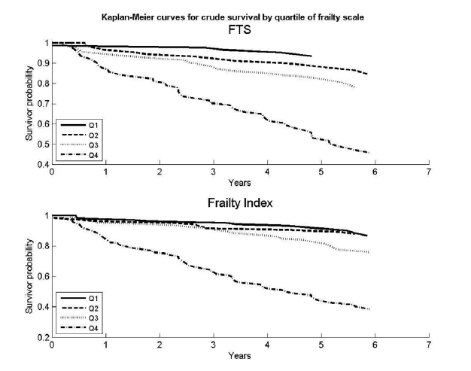
Prospective cohort Study in Spain – 1,825 people ≥ 65 y, 5.5 years of follow up
N=365 people with diabetes
Mortality higher in diabetes: HR 1.36 (1.06-1.75)
Only age and frailty (but not comorbidity or cardiovascular/cerebrovascular disease) predicted mortality and disability

Slide 11

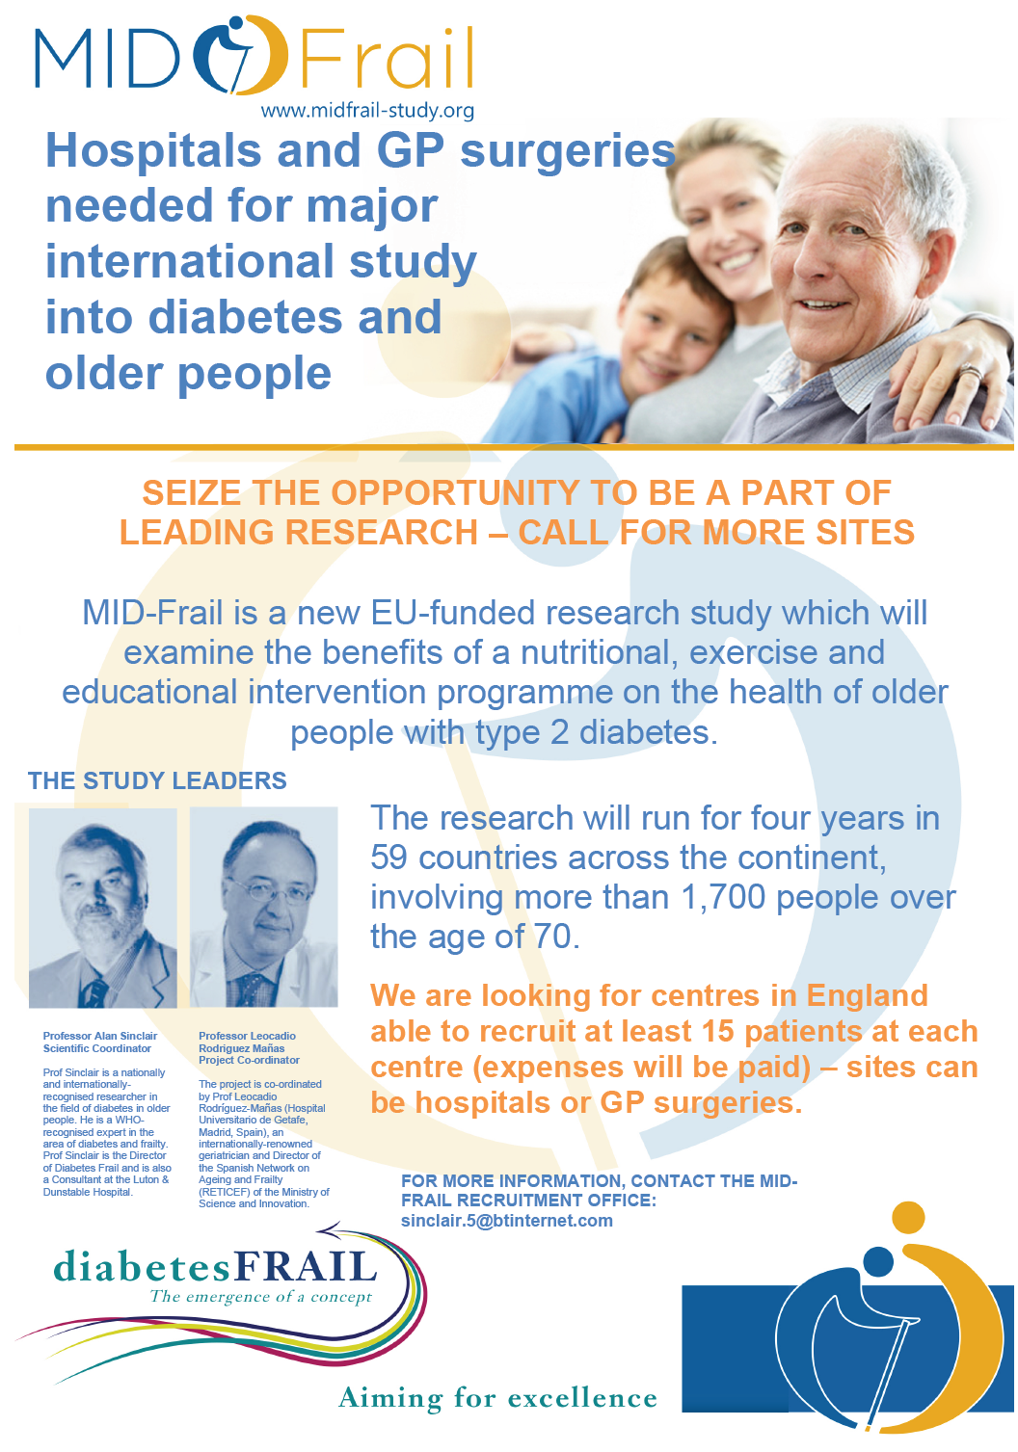
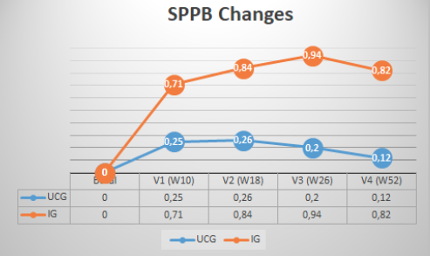

Frailty in Diabetes is reversible
≈ p< 0.01 vs UCG
*
* P < 0.01 vs baseline
*
≈
*
*
≈
≈
≈
J Cachexia Sarcopenia Muscle. 2019 Apr 23.[Epub ahead of print]
Effectiveness of a multimodal intervention in functionally impaired older people with type 2 diabetes mellitus.
Rodriguez-Mañas L¹, Laosa O², Vellas B³, Paolisso G⁴, Topinkova E⁵, Oliva-Moreno J⁶, Bourdel-Marchasson I⁷, Izquierdo M⁸, Hood K⁹, Zeyfang A¹⁰, Gambassi G¹¹, Petrovic M¹², Hardman TC¹³, Kelson MJ¹⁴, Bautmans I¹⁵, Abellan G³, Barbieri M⁴, Peña-Longobardo LM⁶, Regueme SC⁷, Calvani R¹¹, De Buyser S¹², Sinclair AJ¹⁶; European MID-Frail Consortium.
MAIN RESULTS at 1 YEAR

Slide 12
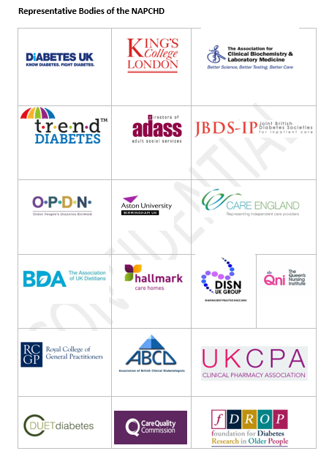

Stakeholder and Advisory Representatives
Available at: http://fdrop.net/napchd

Slide 13

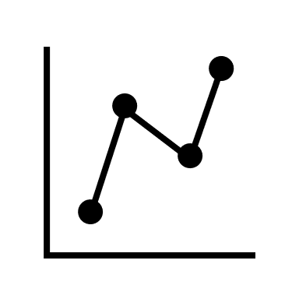




Research Gaps
The Growing Role of Technology in the Care of Older Adults With Diabetes Diabetes Care 2023
  Clinical effectiveness in diverse older adults
  Impact of long-term technology use on patient- and caregiver- reported outcomes
  Strategies to deploy technology for older adults across health status categories
  Integration with other remote patient monitoring
  Interventions to address provider-level and structural barriers to technology adoption
  Economic evaluation
Diabetes Technology
  Continuous glucose monitoring
  Insulin pumps
  Bluetooth enabled insulin pens
  Automated insulin delivery systems
Current Evidence
  Diabetes technology trials have included ambulatory adults in 60’s using insulin
  Lack of studies in adults over 70’s and 80’s
  Lack of studies in complex, multimorbid, functionally-impaired
Clinical Implementation Challenges
  Inequities in structural factors, social determinants of health, and access to technology and its resources (e.g., internet)
  Variable technologic literacy and attitudes towards technology in older adults
  Limited primary care provider education, experience, and resources for starting or utilizing diabetes technology
  Limited long-term care provider and staff education on technology
  Lack of integration into electronic health records
Older Adults Living with Diabetes
  Growing population of adults ages ≥65 years of age with type 1 and 2 diabetes
  Heterogenous biopsychological needs
  Distinct priorities of care
Elbert S. Huang, Alan Sinclair, Paul R. Conlin, et al.
Notes:
https://www.omnipod.com/current-podders/resources/omnipod-5/faqs/smartadjust-technology
Research Gaps
Technology and patient-centered outcomes
Technology integration
Technology in Type 1 diabetes
Technology in Type 2 diabetes
New metrics and targets for healthy, pre-frail, and frail older adults
Technology deployment across health status categories
Barriers to adoption (structural inequities)
Barriers to adoption (providers)
Barriers to adoption (policy)
Cost implications of new technology
Challenges for Clinical Implementation
Inequities in structural factors, social determinants of health, and access to technologic resources (e.g., high-speed internet)
Variable technologic literacy and familiarity among older adults
Variable health literacy
Limited primary care provider education, experience, and resources for diabetes technology
Limited long-term care provider and staff education on technology
Inadequate long-term care staffing
Legal, financial, and Security Barriers to Incorporating Diabetes Software into Health Systems

Slide 14
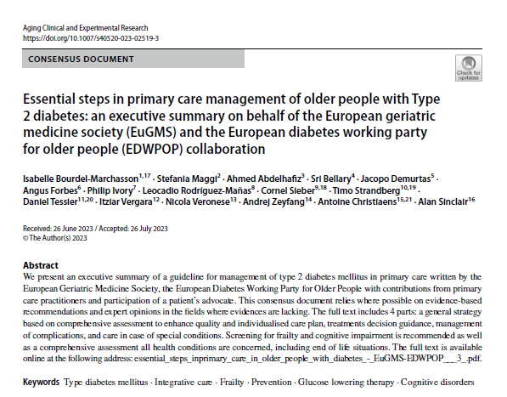
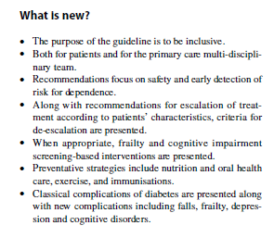
EuGMS and EDWPOP Primary Care Guidelines 2023

Slide 15
Rationale and Defining Special Needs of Older Adults with Diabetes
Rationale
Special Needs
Since 2000, >50% people receiving treatment for diabetes are aged >70y
In Europe, up to 26% of adults have been diagnosed with diabetes
Long standing chronic disease associated with increased disability, poor quality of life, and worse survival
Nearly 7% of total healthcare costs (for direct care) in Europe
An interdisciplinary healthcare approach with a primary care focus
Maintaining independence as long as possible, as well as safety and recognition of early declines in health status
Minimise risk of hospital admissions and institutionalization
Upholding the highest level of quality of life and end of life
Promotion of research and audit

Slide 16
Methods
Collaboration between EuGMS-EDWPOP organisations
European specialists in diabetes, geriatric medicine, and primary care with PLWD representation
Multiple online meetings (work started during COVID-19)
Extensive literature searching
Numerous Discussions on each area of guidance
Several draft revisions (at least 5)
Grading of Evidence
Based on evidence available and international expert consensus:
Grade 4A: higher strength – evidence from meta-analyses or systematic reviews of RCTs, or RCTs with low risk of bias
Grade 3A: moderate strength – evidence from RCTs with a higher risk of bias, systematic reviews well-conducted cohort or case control studies
Grade 2A: lower strength – evidence from well-conducted cohort or case control studies
Grade 1A – Expert opinion – no direct evidence available – but can be used as a Good clinical practice indicator

Slide 17
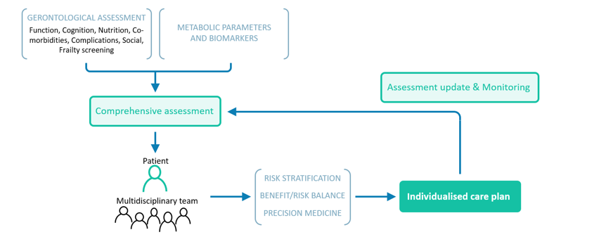
EuGMS-EDWPOP Guideline 2023 – Overview of the Guiding Principles of the Individualised Care Plan

Slide 18
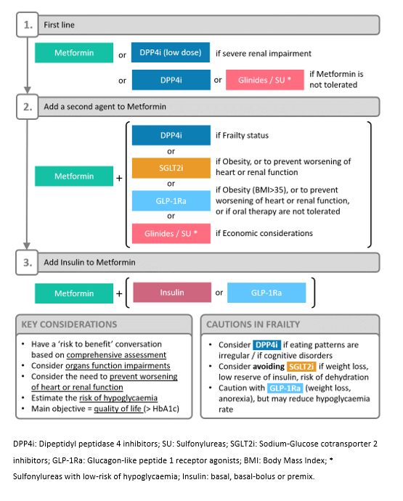
A Pathway of Glucose-Lowering Treatment

Slide 19
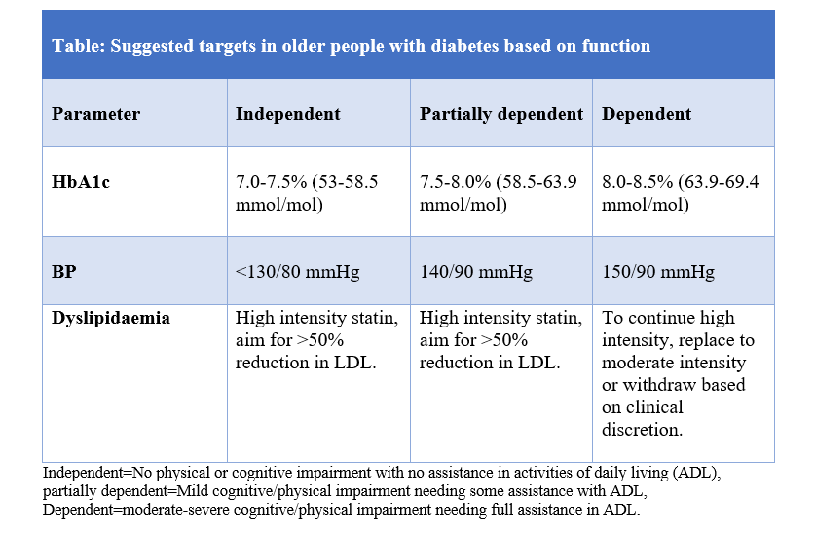
Guideline Metabolic Targets

Slide 20
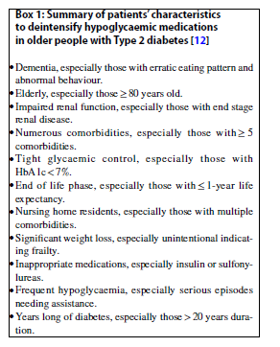
De-Escalation (DEINTENSIFY) – a method to improve care, safety and simplify complex treatment
Abdelhafiz AH, Sinclair AJ, J Diabetes & Complications (2018)

Slide 21
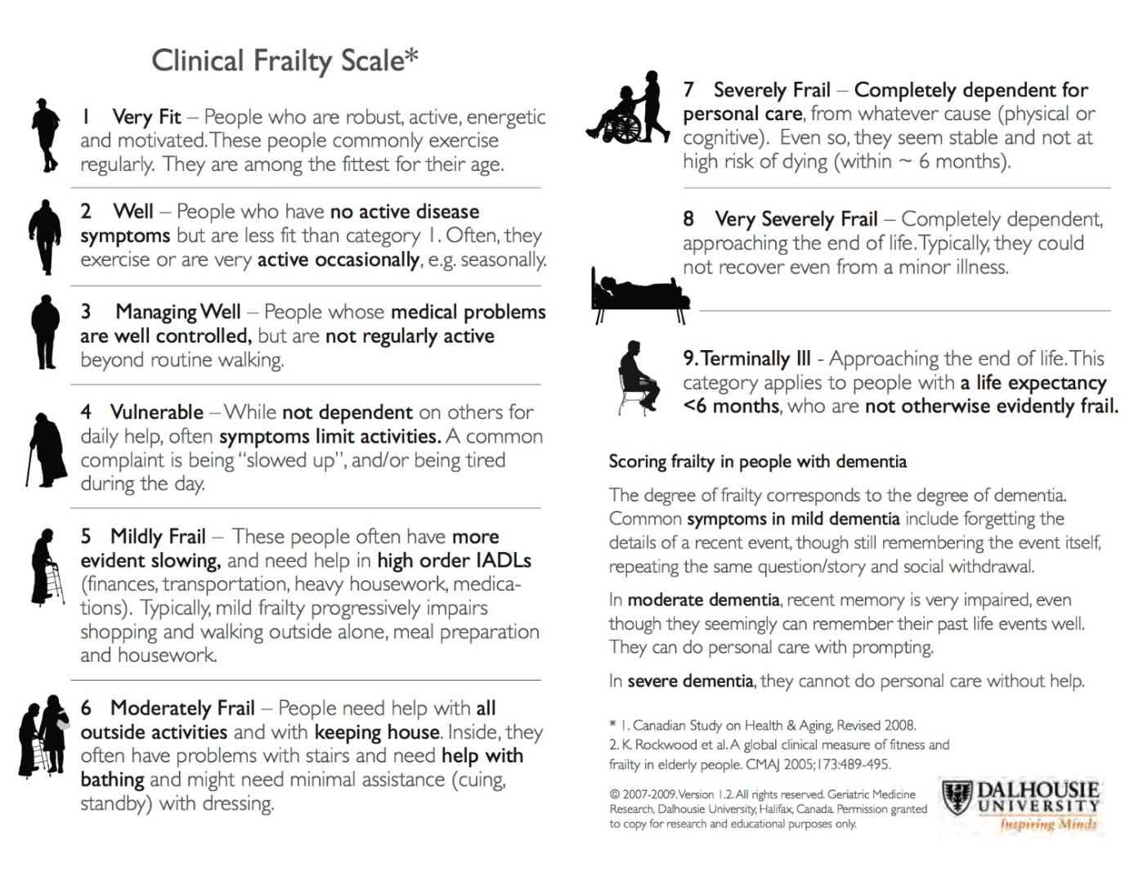
Primary Care - measuring frailty – Clinical Frailty Scale (CFS) and Electronic Frailty Index (eFI)
eFI tool
The eFI consists of 36 deficits which have been constructed using around 2,000 primary care Read codes
Requires a software system in place, e.g EMIS Web
The eFI calculates a frailty score by dividing the number of deficits present by the total possible: uses 36 validated deficits
Scores
Robust – 0-0.12; Mild – 013-0.24; Moderate – 0.25-0.36; Severe - = >0.36
The score is a robust predictor of those who are at greater risk of adverse outcomes: an eFI > 0.36 have a six-fold increased risk of admission to a care home in the next 12 months and a five-fold increased mortality risk, compared with fit older people
Clegg A et al, 2016
Cumulative Deficit Model of Frailty: derivation of the Electronic Frailty Index Rockwood K et al, 2007

Slide 22
FRAIL TEST – non-invasive frailty screening tool
– a preferred frailty measure Morley JE et al 2012
The clinician asks:
Advantages of Test
Fatigue: Are you fatigued?
Resistance: Are you unable to walk up one flight of stairs?
Aerobic: Are you unable to walk one block?(equivalent of about 200m)
Illnesses: Do you have more than 5 illnesses?
Loss of weight: Have you lost more than 5% of your weight in the past 6 months?
Interpretation: Answers yes to:
1-2: indicates pre-frailty, and ≥3: indicates frailty
Simple, easy to learn
Does not require a face to face consultation
Utilises 4 components of the Cardiovascular Study Index (Fried Criteria) and 1 component from the Rockwood Clinical Frailty Scale
Correlates well with IADL, gait speed and SPPB
Valid in late middle age and older adults
Rosas-Carrasco O et al, 2010 (Mexicans);
Li Y et al 2015 (Chinese); Ravindrarajah R et al 2013 (Europeans)
Notes:
An alternative frailty screening tool is the FRAIL SCORE which is a 5-item questionnaire only. This is becoming increasingly popular among health professionals and is easy to perform.

Slide 23
Multi-domain Individualised Management Planning Sinclair AJ, EASD 2022
Glucose and HbA1c Targets
IDF (2014), AES(2019); SGLT2-I and GLP-1 RA meta-analyses
Physical Exercise with Nutritional Education
ADA (2022), MIDFRAIL (2019), SPRINTT (2022)
Blood Pressure Targets
SPRINT (2016), ADA (2022)
Comorbidity
Profiles and Management
Effective Guidance not available
De-Escalation Therapy and Hypoglycaemic avoidance
Abdelhafiz A, Sinclair AJ (2017); Niznik JD (2022); Belmonte LM (2021); Sonnez A (2021); Pinda DV (2019)
Use of Technology and Diabetes
Self-Management
DIAMOND TRIAL (2017), TOSCHI E, Munshi M (2019); McAuley SA (2022)
Frailty Management
IDF (2014), AES (2019), ADA (2022)
JBDS-IP (UK) 2019/22; International Expert Group 2017)
Preliminary Precision Medicine Approach
Ahlqvist E (2018), Chtristaens A (2019), Sinclair A and Abdelhafiz AH (2021/2), Huang Es et al, 2023
Notes:
To conclude, for the present and near future, we must accept that we require a multidomain individualized management plan for the treatment of type 2 diabetes in older adults as shown in this slide.
Emphasis should continue on effective glucose-lowering algorithms, de-escalation therapy, lifestyle changes, frailty and comorbidity management, and developing the roles of medical technology in diabetes self-management.
Precision Medicine is important but the evidence base particularly in older people needs strengthening.
Thank you.

Slide 25
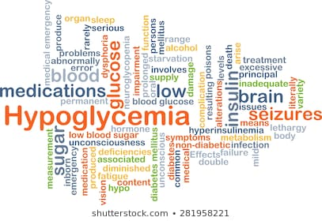
Hypoglycaemia – an inevitable consequence in older people with diabetes taking sulphonylureas or insulin
Multiple contributory factors
Neuropathy, impaired renal function, cognitive defects and frailty
Kirkman MS et al, 2012; Kostev K et al, 2014; Sinclair AJ et al, 2015
Reduced Hypoglycaemic Awareness
Meneilly G et al, 1994; Bremer JP et al, 2009; Zammitt NN & Frier B, 2005
Severe consequences
CV events and all-cause mortality, falls, deterioration in general health, cognitive impairment, hospital admissions, frailty
Khunti K et al, 2015; Sinclair AJ et al, 2012; Abdelhafiz A et al, 2015

Slide 26
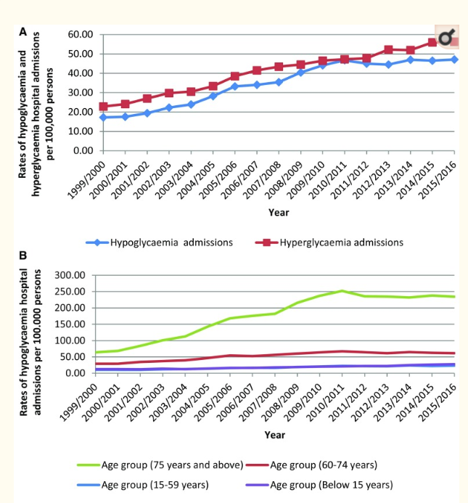
Hospital Admissions in England and Wales (1999-2016) for Dysglycaemia
Naser AY et al, Diab Ther 2018
Observational study of all hospital admissions for hypoglycaemia and hyperglycaemia
Hospital Episode Statistics database in England and the Patient Episode Database for Wales
173% increase in hypoglycaemia for the period
Strong relationship between hypoglycaemia and parallel increase in glucose-lowering medications

Slide 27
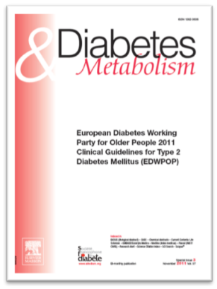
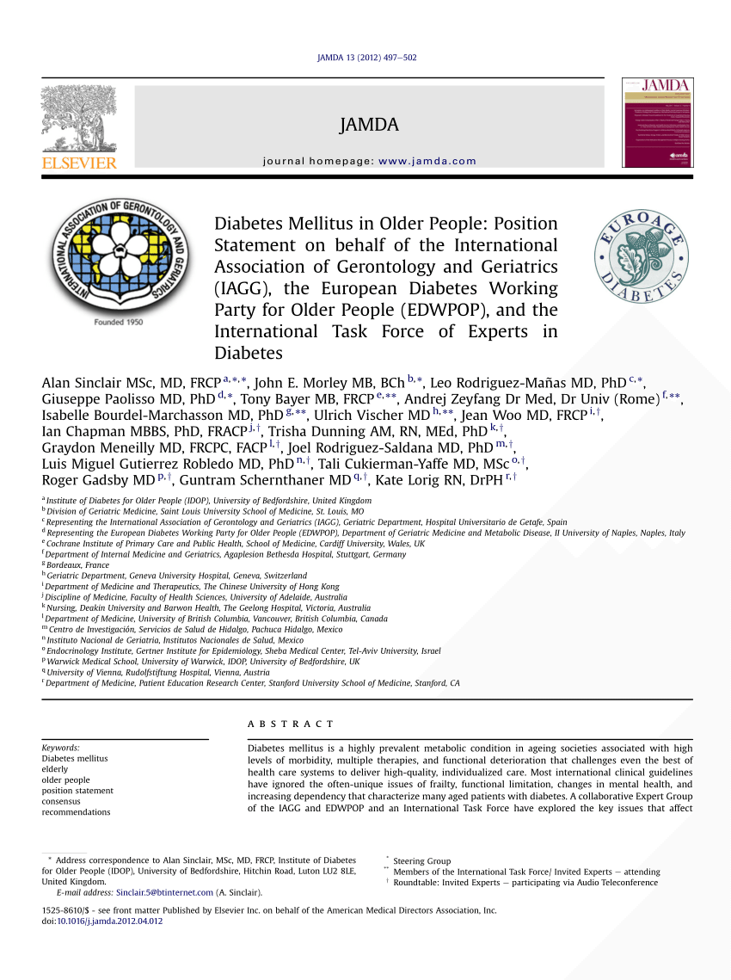
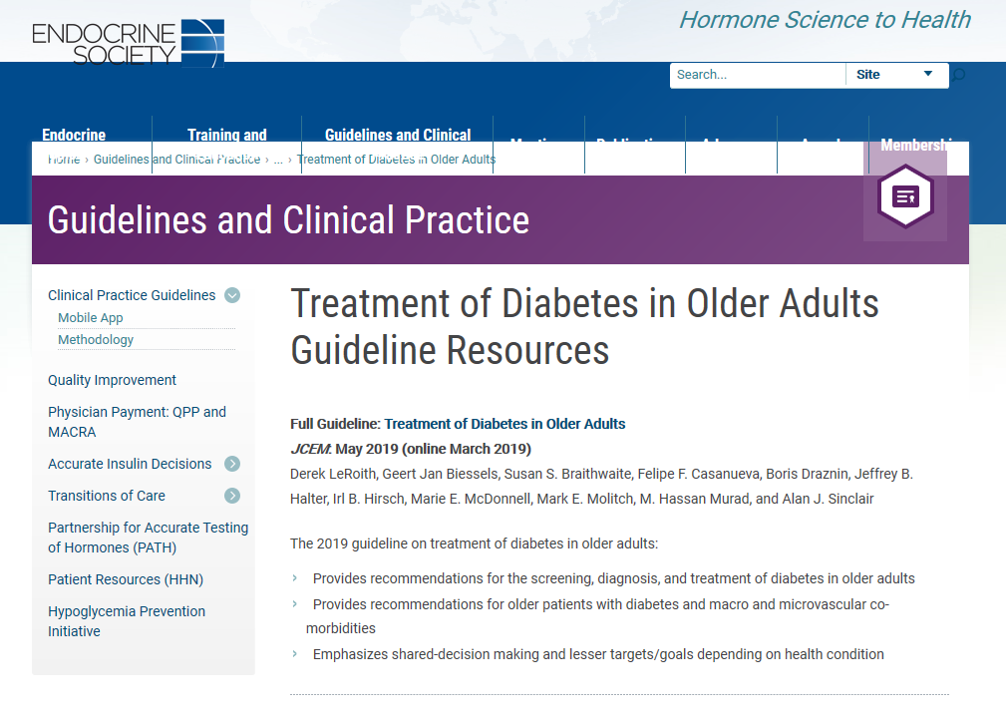
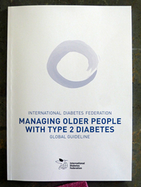
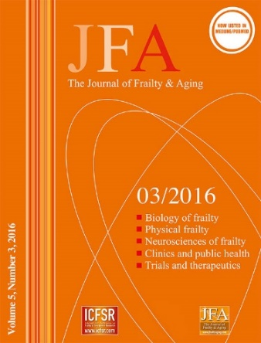
Shortcomings of Clinical Guidelines: DO NOT answer some of the Key Questions in Management
International Guidelines
They DO NOT Answer:
What are the elements of a successful de-escalation approach to management?
Is a different approach to managing comorbidity and/or frailty necessary?
Why a single gluco-centric approach in any case would suit all patient groups and needs of a complex illness model?
How do we distinguish the various groups of older people with diabetes who are more likely to benefit from specific treatment approaches?
Should we consider a more precision medicine approach?
Notes:
I am forced to admit that recent clinical guidelines developed by expert groups have considerable shortcomings and fail to provide answers to key questions. Although I have been significantly involved in the 5 guidelines shown on the left, I need to conclude that a number of areas of importance are not covered.
These include : a lack of guidance on de-escalation treatment, lessening the impact of the glucocentric approach to therapy, failing to distinguish the more likely groups of older adults that will benefit the most from treatment, and so on.
It is inevitable that we should ask ourselves if a Precision Medicine approach is necessary?

Slide 28

Diabetes in Older Adults – a High Risk Health State
Normal Glucose Handling
Independent statement: Variable age-related decline in fasting and post-prandial glucose
Genetic, behavioural and environmental influences
Decreased glucose-induced β-cell insulin release
Loss of normal pulsatile release and reduced 2nd phase insulin release
3 – 6 years
Increasing insulin resistance in muscle / fat tissues
Age-related loss of lean body mass; increased visceral adipose and increased intramuscular fat
Obesity, medications
Physiological type 2 Diabetes
1 – 3 years
Illness mimicking: with non-specific fatigue, weight loss, behavioural change
Attenuated symptom response to elevated glucose
Clinical diagnosis of type 2 Diabetes – delayed diagnosis*
Progressive hyperglycaemia
Emerging cardiovascular disease
Development of non-cardiac vascular disease and microvascular complications
Insidious functional decline, frailty and sarcopaenia
0 – 3 years
High Risk Health State
Consequences of High Risk Health State
Ischaemic heart disease and heart failure
Renal disease, visual loss, foot disease, PVD
Cognitive impairment
Hypoglycaemia and Falls
Immobility, and poor self-care
Loss of independence altered quality of life
Adapted from: Sinclair AJ, Abdelhafiz A, Forbes A, Munshi M, Diabetic Med 2018
Complex Illness Model

Slide 29
Proposed comorbidity - frailty pathways to disablement Sinclair AJ/Abdelhafiz AH 2022
COMORBIDITY PATHWAY
FRAILTY PATHWAY
Several clinically manifest organ dysfunctions (comorbidity)
Multiple subclinical organ dysfunction
Exogenous and Endogenous ‘stressors’ leading to frailty
Increasing age
Anorexia of ageing
Weakness
Weight loss
Falls
Reduced balance
Slowness
Reduced performance
Wasting/sarcopaenia
Reduced endurance
Chronic inflammation and immune dysfunction
Progressive physiological decline and homeostatic dysfunction due to increasing stressor load
Multi-morbidity
Frailty
+
Various additive or synergistic effects depending on pattern of multimorbidity:
MSO
NMH
CVD
Varied effects depending on severity of frailty:
Mild
Moderate
Severe
New functional decline
Further functional decline
A Disablement Process
MSO – musculoskeletal; NMH – neurological/mental health; CVD – cardiovascular: Aust Long Study Womens Health, 2015
Increased Mortality

Slide 30
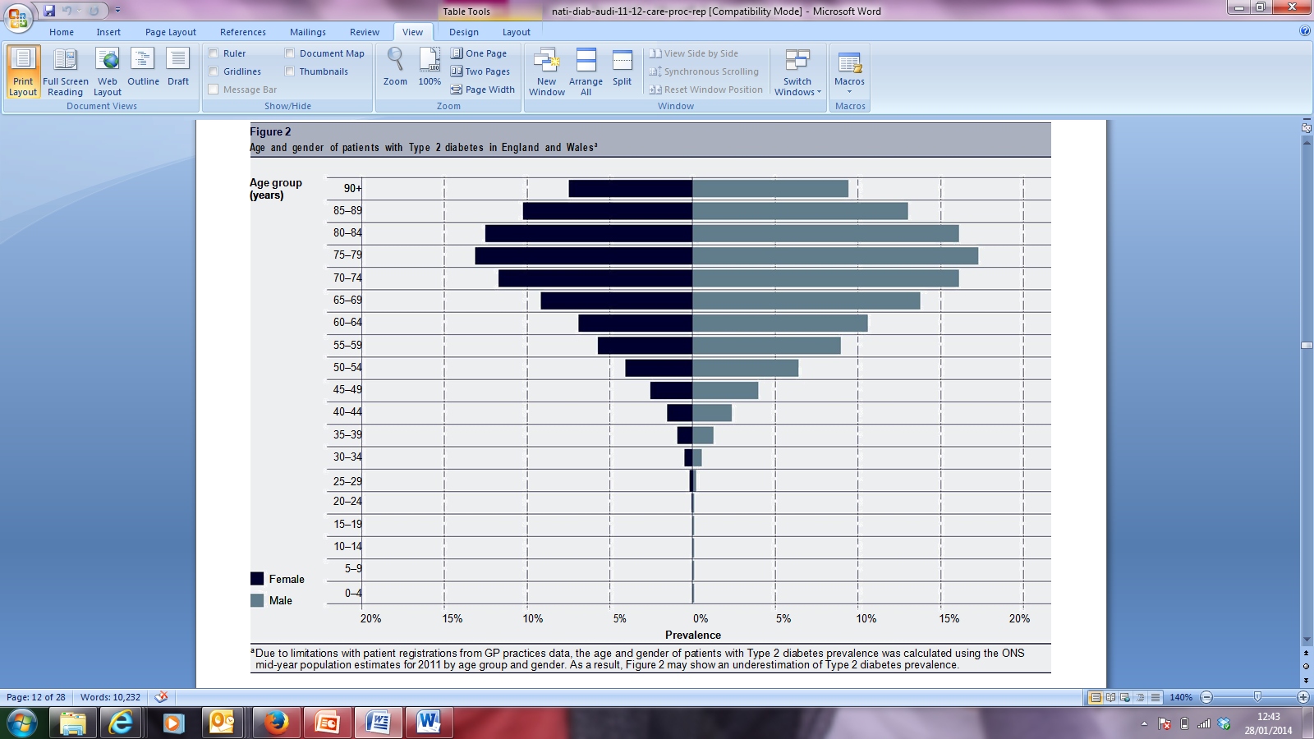
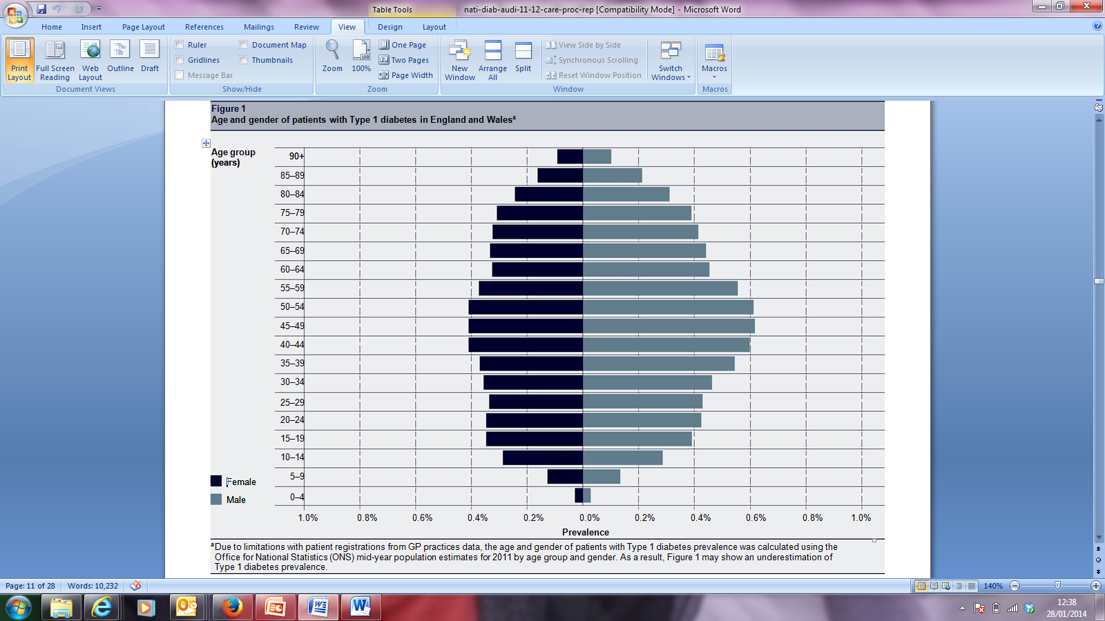

Comparison of Distribution of people with types 1 and 2 diabetes in England and Wales -2011
Type 2 diabetes prevalence
Type 1 diabetes prevalence
Health & Social Care Information Centre, NDA, 2013
Notes:
See lancet paper

Slide 31
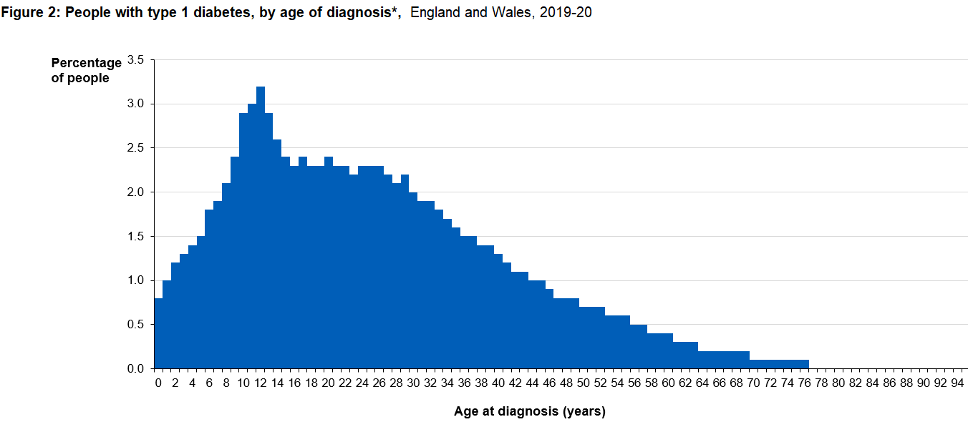
Type 1 diabetes in England & Wales – 2019-20 NDA Supporting Information

Slide 32
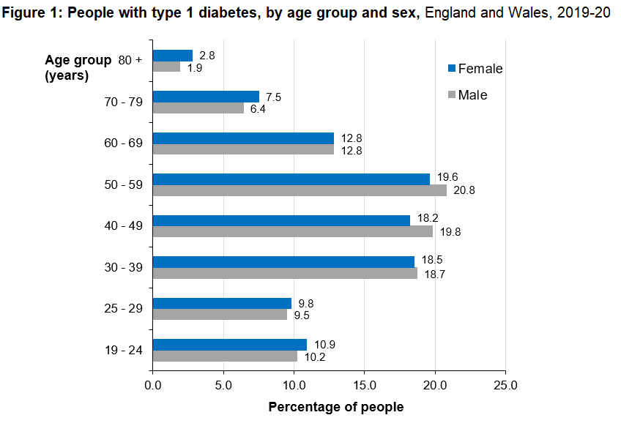
Type 1 Diabetes – NDA 2019-20
86.2% white
3.5% Asian
2.3% Black
2.1% Mixed/other
9.5% not known
218, 670 confirmed and unconfirmed cases of type 1 diabetes: 56.9% Male
Courtesy of Prof Robert Young; source NHS Digital

Slide 33
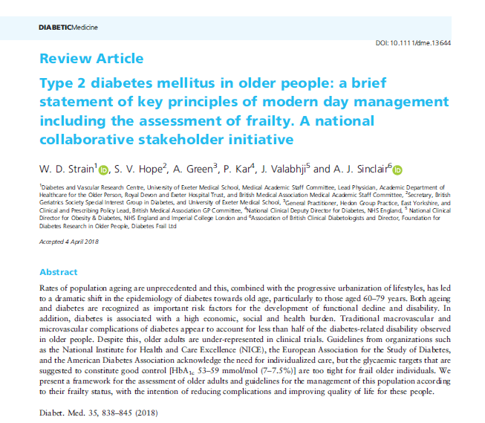
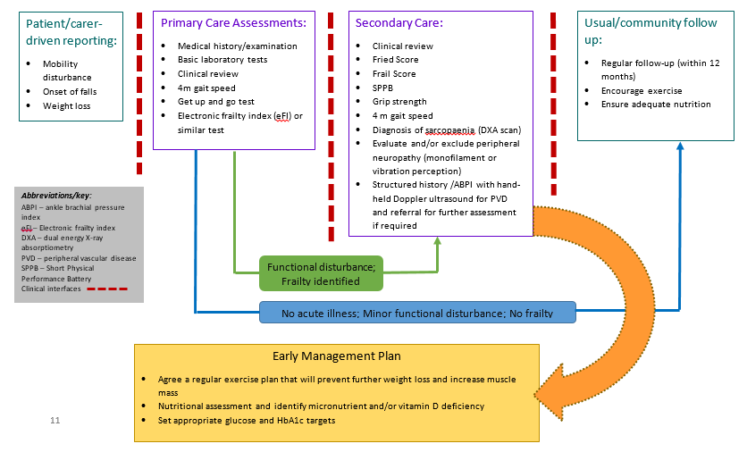
National Stakeholder Group Responds to NHS Concerns on Frailty
Based on: International Position Statement on the Management of Frailty in Diabetes, Sinclair AJ et al, 2017 and Strain WD et al, 2018

